Slide 1



Online Complaint Registration & Management System
"Streamlining Complaints, Enhancing Transparency"
Team ID : LTVIP2025TMID52050
Team Members;
Shaik Samrin
Yaramakula Karthik Reddy
Mungara Himabindu
Morla Dileep

Slide 2
Introduction
The Online Complaint Registration and Management System is a software platform designed to digitize and streamline the process of submitting, tracking, and resolving complaints.
It serves as a centralized hub for users to report issues, interact with support agents, and monitor resolution progress in real time.
This system aims to replace manual, paper-based processes with an automated, transparent, and user-friendly solution.
Improves customer satisfaction by providing real-time updates and direct communication with support agents.
Complies with modern digital governance and customer service standards.

Slide 3


Problem Statement
01
Current Issues: Traditional complaint systems rely on paperwork, leading to lost requests and slow responses.
02
Security Risks: Paper-based systems are prone to data breaches and mishandling.
03
Inefficiency: Manual tracking makes it difficult for organizations to prioritize and resolve complaints.
04
Lack of Transparency: Users often don’t receive updates, causing frustration and distrust.
Solution Offered: Our system automates the process, ensuring speed, security, and user satisfaction.
05

Slide 4
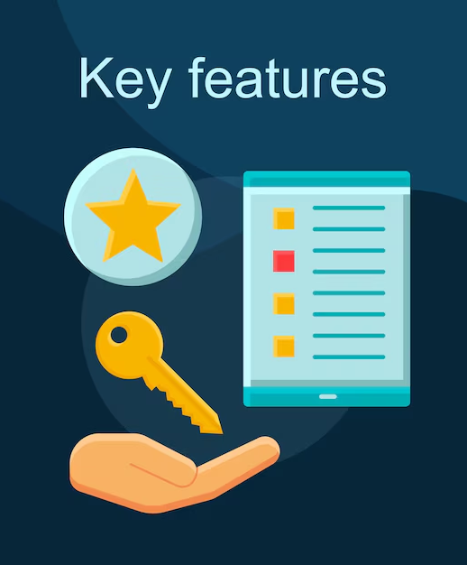
Key Features
User-Friendly Interface: Simple design ensures easy navigation for all users.
Role-Based Access: Different dashboards for users, agents, and admins for better workflow management.
Real-Time Tracking: Users can check complaint status anytime, reducing follow-up calls.
Automated Notifications: Email/SMS alerts keep users informed at every stage.
Secure Messaging: Built-in chat allows direct communication between users and agents.
Analytics Dashboard: Admins can generate reports to analyze complaint trends and resolution efficiency.

Slide 5




Technologies Used
FrontEnd
BackEnd
React.js → Dynamic UI components
Material UI → Pre-built design elements
Bootstrap → Responsive layouts
Axios → API communication
Socket.io Client → Real-time chat
Node.js → Server runtime
Express.js → REST API framework
JWT → Secure authentication
Bcrypt → Password encryption
Socket.io → Real-time updates
Nodemailer → Email notifications
DataBase
MongoDB → NoSQL database (flexible data storage)
Mongoose → Schema modeling & queries

Slide 6

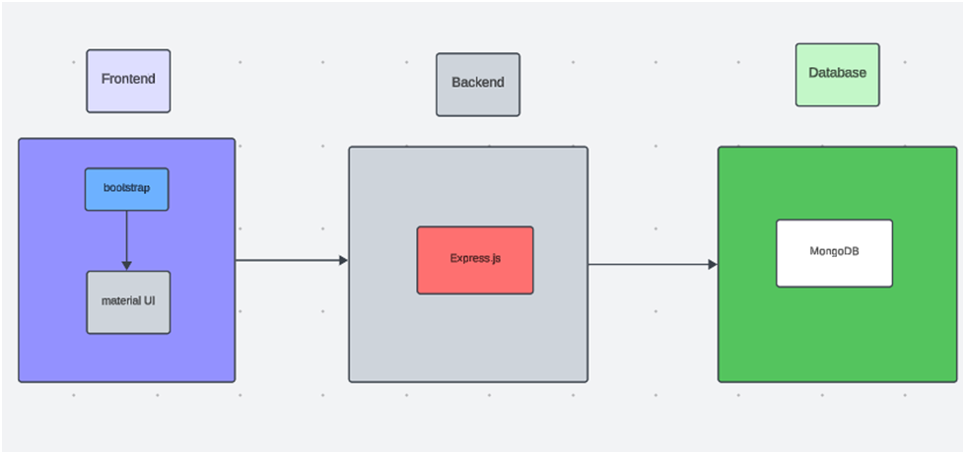

Technical Architecture
Together, the frontend and backend components, along with socket.io, Express.js, WebRTC API, and MongoDB, form a comprehensive technical architecture for our video conference app. This architecture enables real-time communication, efficient data exchange, and seamless integration, ensuring a smooth and immersive video conferencing experience for all users.

Slide 7

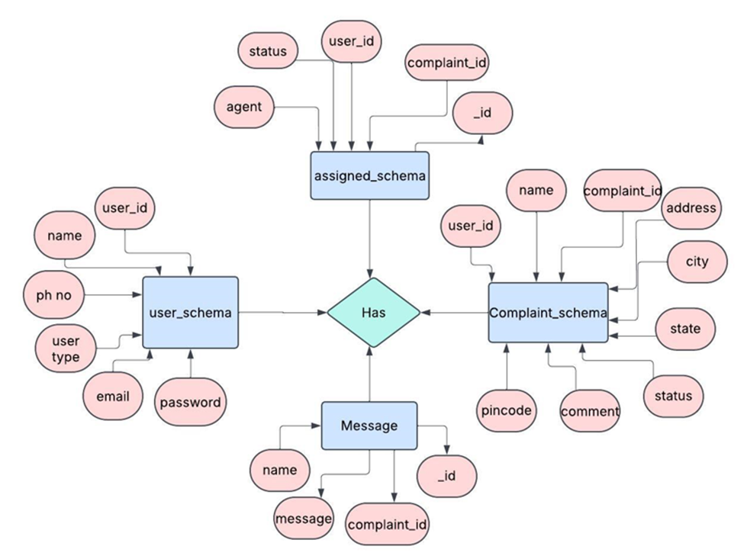
ER Diagram

Slide 8

Project OverFlow
Customer/Ordinary User
Agent
Registration and Login
Complaint Submission
Status Tracking
Interaction with Agents
Profile Management
Registration and Login
Complaint Management
Status Update
Customer Interaction
Admin
Management and Monitoring
Complaint Assignment
User and Agent Management
Continuous Improvement

Slide 9
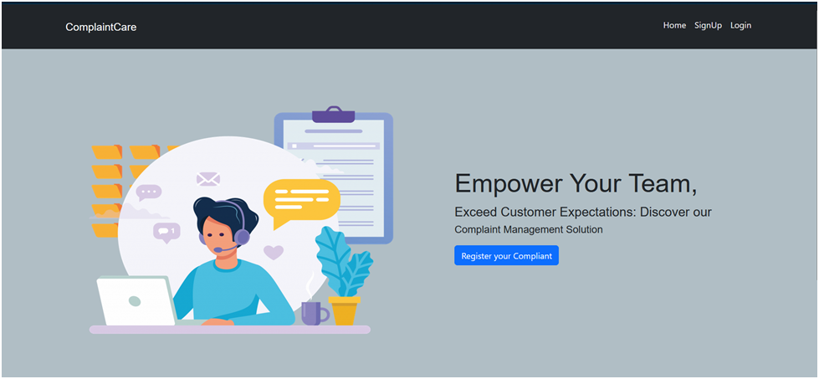
Landing Page
The purpose of this page is to introduce the ComplaintCare system and prompt users to register or log in so they can submit and manage complaints. It serves as a gateway to the complaint management platform with a clear call-to-action for quick complaint registration.

Slide 10

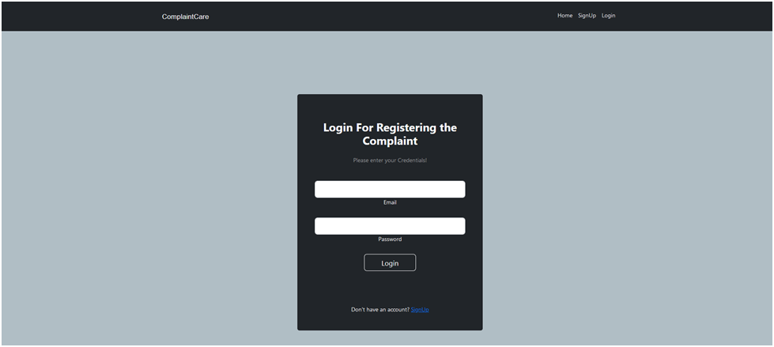

Login Page
The login page provides secure access to the complaint management system, allowing registered users to authenticate and access their personalized dashboard

Slide 11

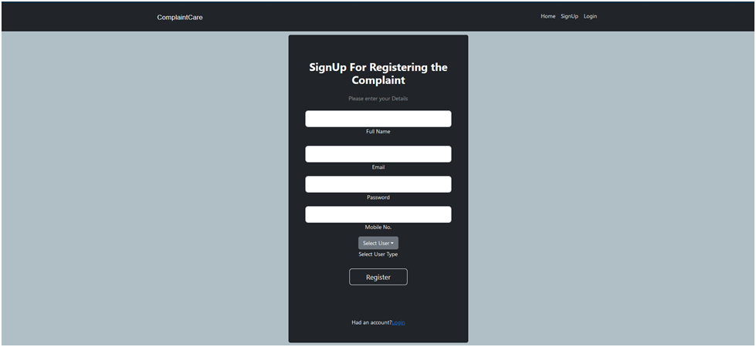
Registration Page
The registration page allows new users to create an account by entering basic details like name, email, and password to access the complaint management system.

Slide 12

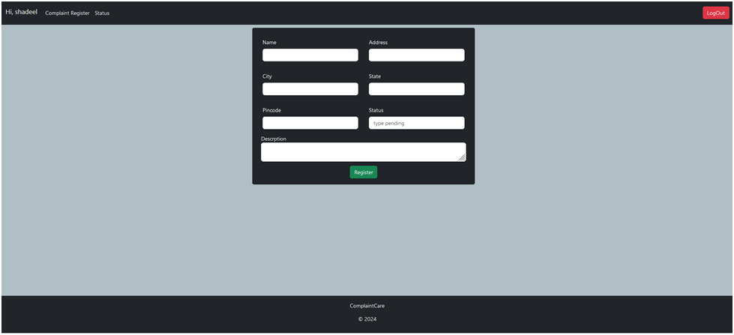
Analysis
This page allows users to register new complaints by entering details (name, address, description) and selecting complaint type/status. It features a clean form layout with a submission button ('Register') and system branding (ComplaintCare)

Slide 13
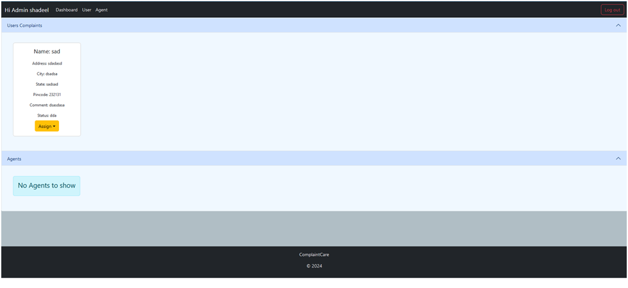
Admin Page
This admin dashboard provides a centralized view for managing user complaints and agent assignments. It displays complaint details (user info, location, status) and includes an agent assignment section, though currently shows no available agents ('No Agents to show').

Slide 14
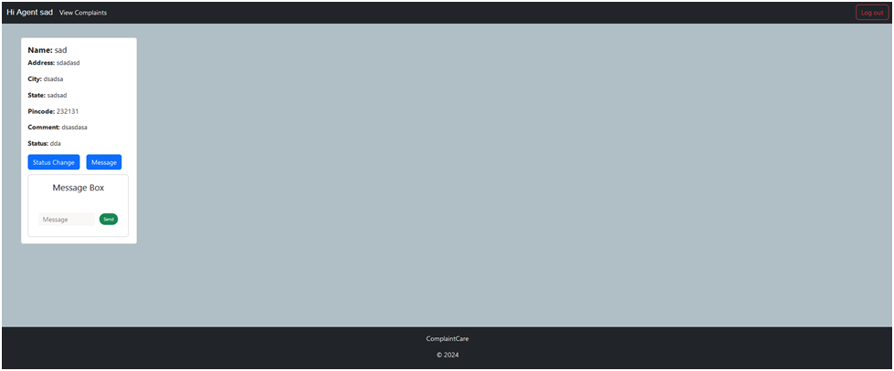
Agent Page
This agent dashboard page displays assigned complaint details and enables agents to manage cases through status updates and direct messaging with users

Slide 15

Thank You

